Slide 1

Neural Networks

Slide 2
Contents
History of Neural networks
McCulloch Pitts neuron
Perceptron
Multi Layer Perceptron
Training MLP
Example
Way to Deep Learning

Slide 3

Inspiration - The Human Brain
Scientists have been fascinated by the Human Brain
Inspired by the ability of the brain to learn from experience
Scientists tried to mimic it and put the same into a computer

Slide 4

Features of the Human Brain
Is highly complex
Is non-linear
Massively parallel
Localized parts of the brain are responsible for certain well-defined functions (e.g. vision, motion).
Structural Constituent - Neuron

Slide 5
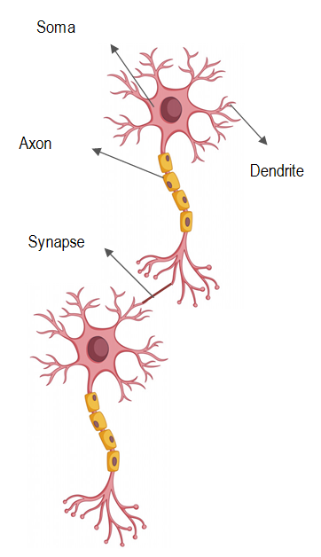
Biological Neuron
Dendrite: receives signal from other neurons
Synapse: point of connection to other neurons
Soma: processes the information
Axon: transmits the output of this neuron
An average brain has 100 billion neurons
A neuron fires only when it has a value greater than the threshold
The neurons are present in hierarchical manner

Slide 6
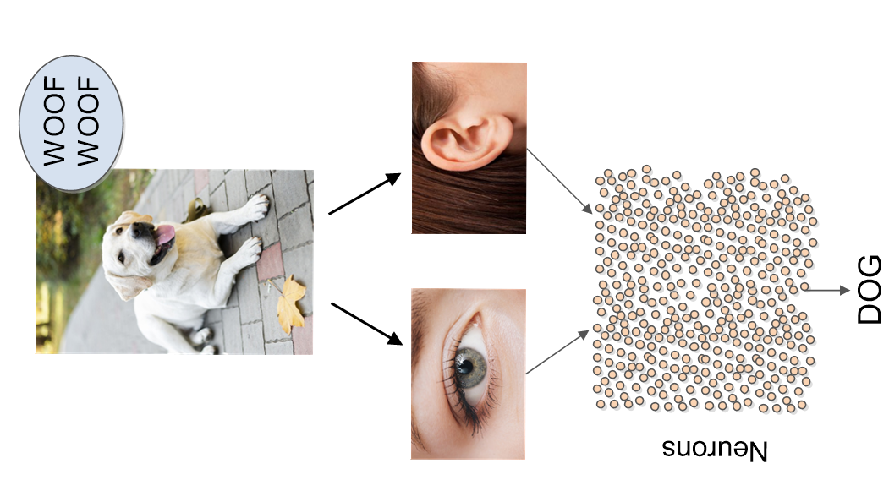
Basic example how neurons work in the brain
Eyes and ears are the sensory organs that receive the input
Organs relay information to the lowest layer of the neurons
Only some of the neurons fire that are directly connected to the sensory organs
Then these neurons may fire other neurons that are connected to them and the process continues until the dog is recognized
Note: Only those neurons are fired that have some contribution towards recognizing the features of the dog

Slide 7
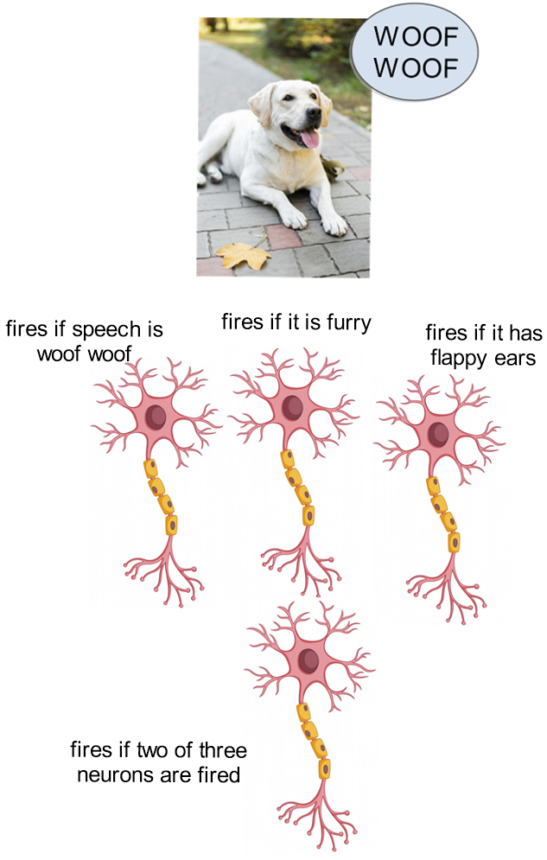
Very basic example how neurons work in the brain
The neurons are present in hierarchical manner and are the processing units of the human brain
There is a massively parallel interconnected network of neurons
Each neuron performs a certain role and responds to a certain stimulus
The neurons in the next layers are fired if the values they are receiving is greater than a threshold value
At every layer some information is processed and the next layer neurons are fired to find new features until the dog is recognized

Slide 8

Applications

Slide 9
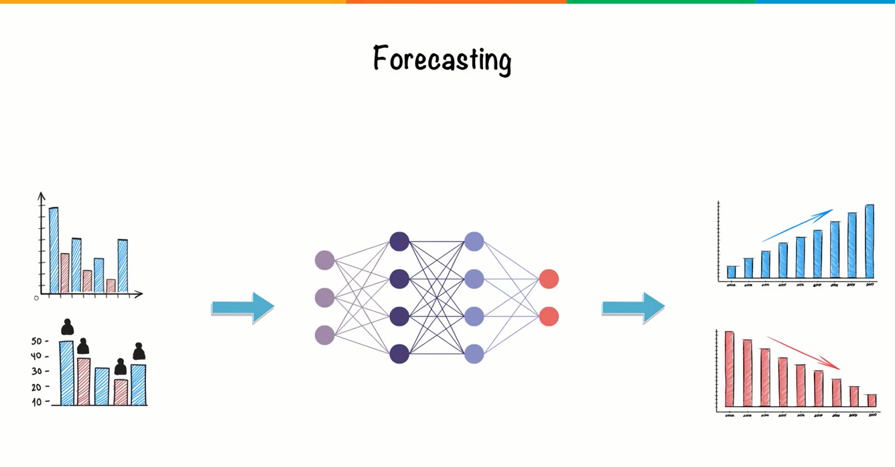
Applications

Slide 10
An artificial neuron is based on the same principle
W1
Processor
Input
W2
Output

Slide 11
History of Artificial Neuron

Slide 12
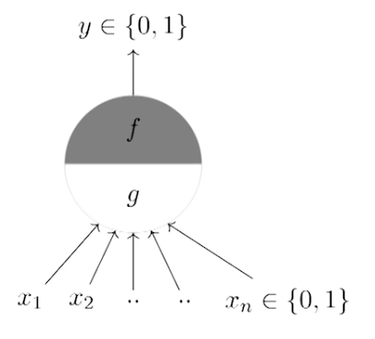
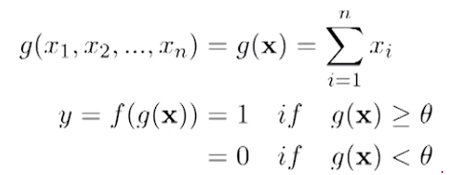
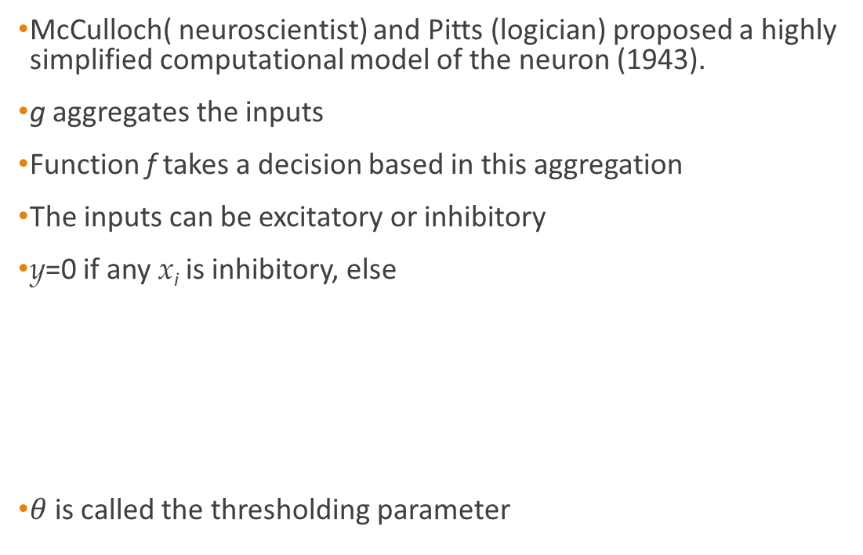
McCulloch-Pitt neuron
McCulloch( neuroscientist) and Pitts (logician) proposed a highly simplified computational model of the neuron (1943).
g aggregates the inputs
Function f takes a decision based in this aggregation
The inputs can be excitatory or inhibitory
y=0 if any x_{i} is inhibitory, else
$θ$is called the thresholding parameter

Slide 13
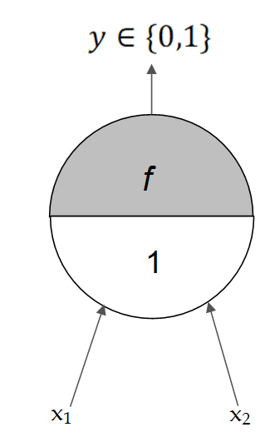
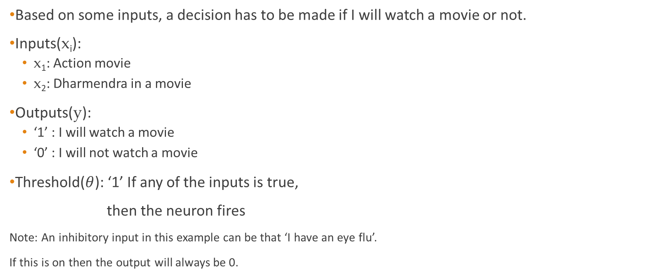
An Example
Based on some inputs, a decision has to be made if I will watch a movie or not.
Inputs(x_{i}):
x₁: Action movie
x₂: Dharmendra in a movie
Outputs(y):
‘1’ : I will watch a movie
‘0’ : I will not watch a movie
Threshold($θ$): ‘1’ If any of the inputs is true,
then the neuron fires
Note: An inhibitory input in this example can be that ‘I have an eye flu’.
If this is on then the output will always be 0.

Slide 14
Features of McCulloch Neuron
A single McCulloch Pitt neuron can be used to represent Boolean functions that are linearly separable.
Linear separability refers to the fact that classes of patterns with n-dimensional vector {x} = (x₁, x₂, ... , x_{n} )can be separated with a single decision surface.
Decision surface can be a linear equation - straight line, a plane or a hyperplane.
The points on one side of the surface are of one kind and on the other are of different kind.

Slide 15
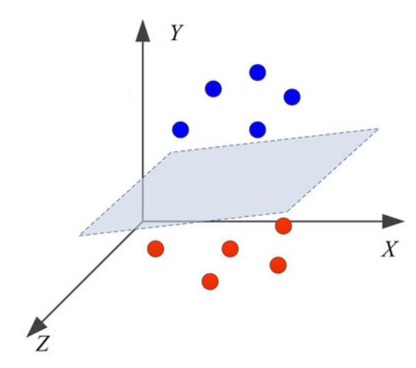
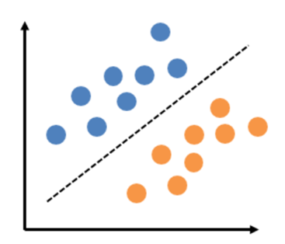
Linear separability
Points in 2D : line y=mx+c
Points in 3D: plane ax+by+cz=d

Slide 16
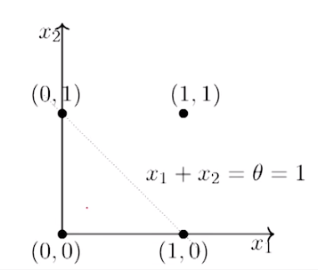
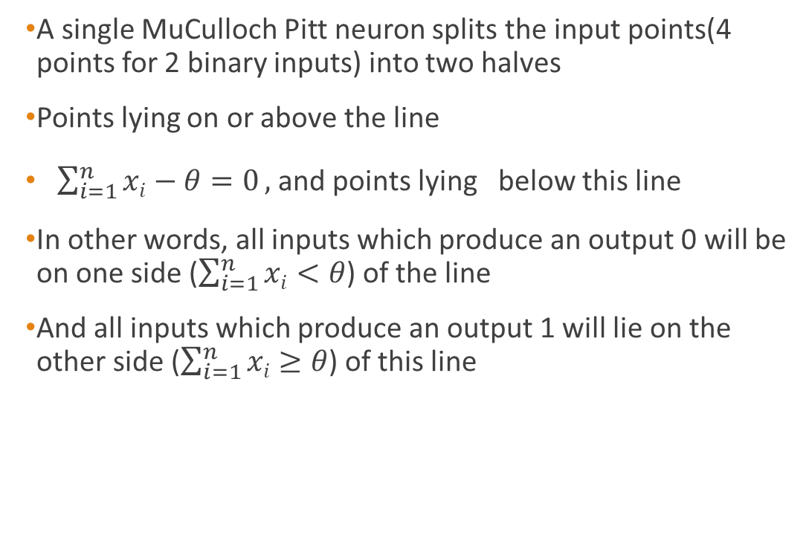
Example: 2 input OR function
A single MuCulloch Pitt neuron splits the input points(4 points for 2 binary inputs) into two halves
Points lying on or above the line
$\sum_{i=1}^{n}{xi−θ=0},$and points lying below this line
In other words, all inputs which produce an output 0 will be on one side ($\sum_{i=1}^{n}{xi<θ}$) of the line
And all inputs which produce an output 1 will lie on the other side ($\sum_{i=1}^{n}{xi≥θ}$) of this line

Slide 17
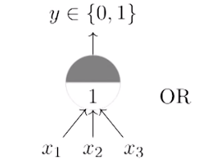
OR with more than 2 inputs
Note: If there are more than three inputs, then the decision surface is a hyperplane.

Slide 18
Conclusion
McCulloch Pitt neuron works on Boolean inputs only
Threshold has to be hand-coded
All inputs are treated as equal
Functions have to be linearly separable

Slide 19
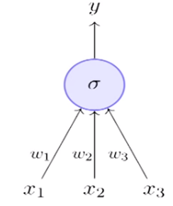
Artificial Neuron- Perceptron
The most fundamental unit of a neural network is called an artificial neuron
It is inspired from biological neuron
Each neuron has a threshold value
Each neuron has weighted inputs from other neurons
The input signals form a weighted sum
If the activation level exceeds the threshold, the neuron “fires”

Slide 20
Single Perceptron
Works on real inputs
Threshold can be learned
All inputs are not treated as equal, they have weights
Functions have to be linearly separable still !

Slide 21
Perceptrons:
inputs
w₁
weights
x₁
w₂
output
activation
Σ
y
x₂
.
.
.
θ
a=^{n}Σ_{i=1} w_{i} x_{i}
w_{n}
Xi’s range: [0, 1]
1 if a ≥ θ
y=
0 if a < θ
x_{n}
{

Slide 22
Why we need Activation functions
Imagine a neural network without the activation functions. In that case, every neuron will only be performing a linear transformation on the inputs using the weights and biases. Although linear transformations make the neural network simpler, but this network would be less powerful and will not be able to learn the complex patterns from the data.
A neural network without an activation function is essentially just a linear regression model.
Thus we use a non linear transformation to the inputs of the neuron and this non-linearity in the network is introduced by an activation function.

Slide 23
Activation functions for units
Step function
(Linear Threshold Unit)
Sign function
Sigmoid function
Relu function
sign(x) = +1, if x >= 0
-1, if x < 0
sigmoid(x) = 1/(1+e^{-x})
f(x) = x , x>=0
0 , x<0
step(x) = 1, if x >= threshold
0, if x < threshold

Slide 24
Multi- Layer Perceptron
Also known as Feed Forward Networks
More powerful than a single layer perceptron
Can learn non linear functions!!!

Slide 25
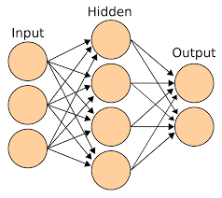
Multi-Layer Perceptron
Composed of several Perceptron-like units arranged in multiple layers
Consists of an input layer, one or more hidden layers, and an output layer
Nodes in the hidden layers compute a nonlinear transform of the inputs
Also called a Feedforward Neural Network
“Feedforward”: no backward connections between layers (no loops)
Note: All nodes between layers are assumed connected with each other

Slide 26
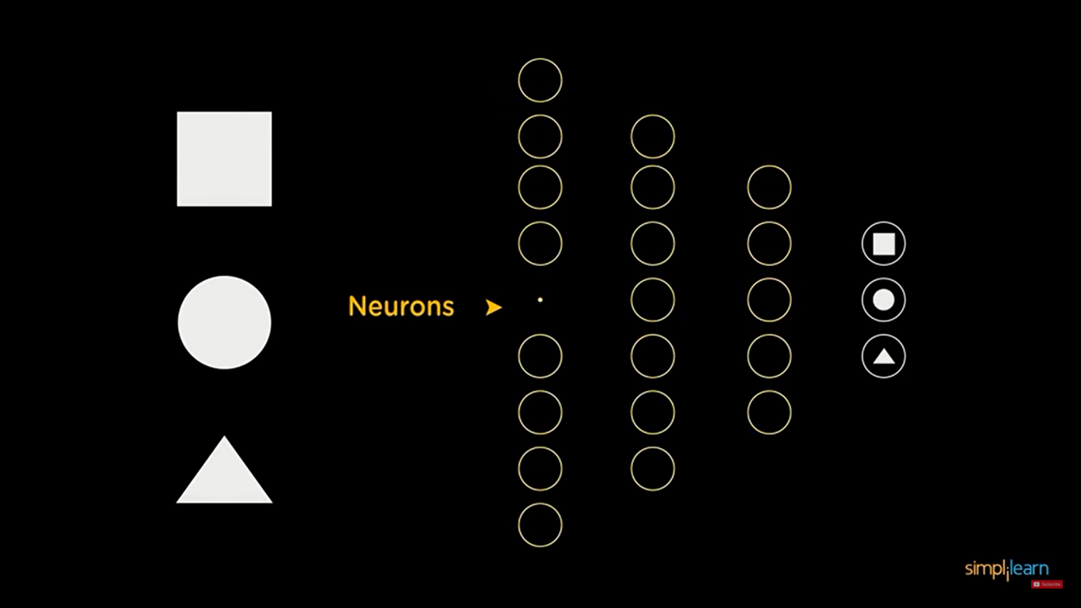
EXAMPLE of Neural Network
Input layer
A neural network that differentiates between square, circle and triangle.
Neural networks are made up of layers of neurons.
Neurons are the core processing unit of the network.
We have a input layer that receives the input.
Output layer predicts the final output.
In between exist the hidden layers which performs most of the computations required by the network.
Output layer

Slide 27
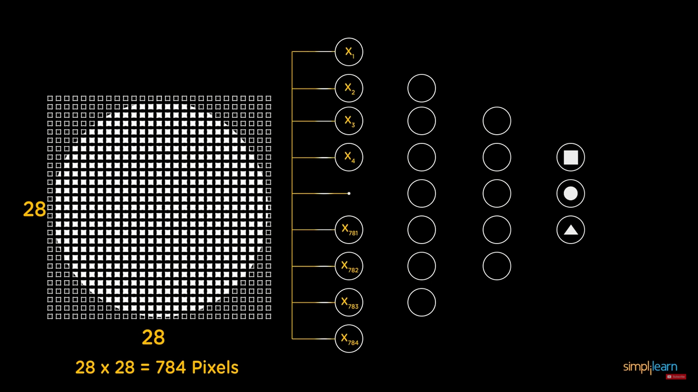
Example

Slide 28
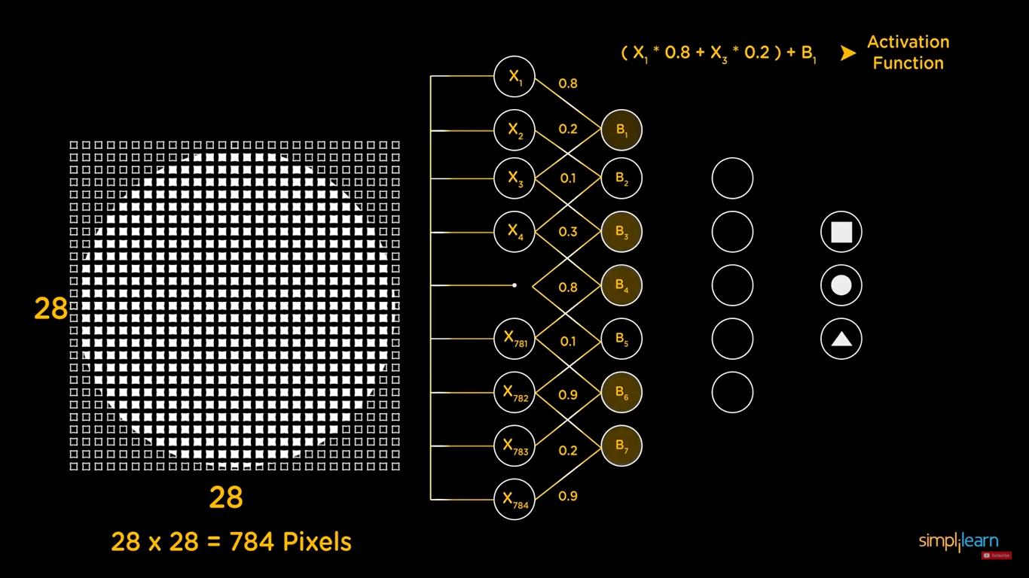
Example

Slide 29
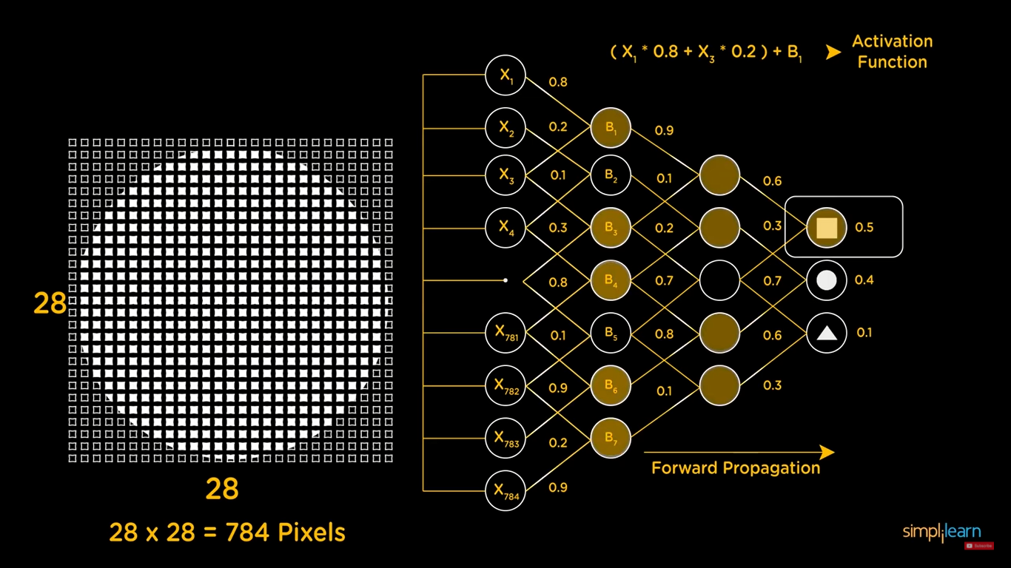
Example

Slide 30
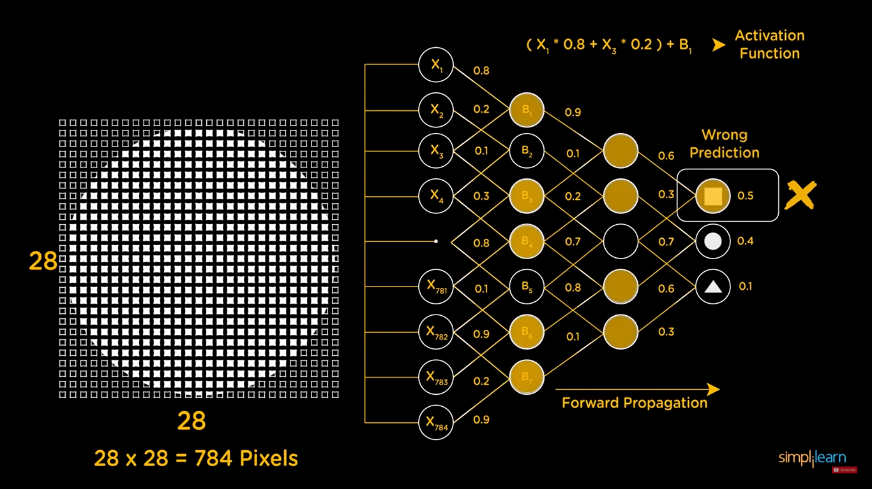
Example

Slide 31
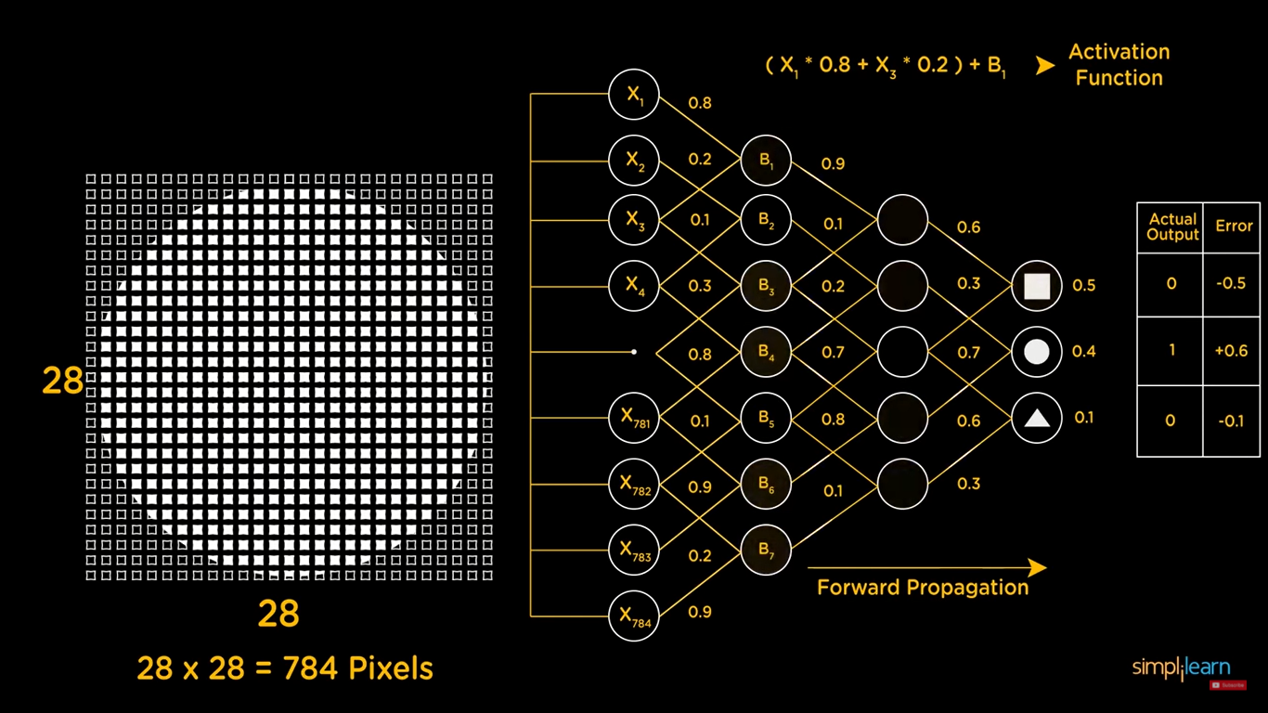
Example

Slide 32
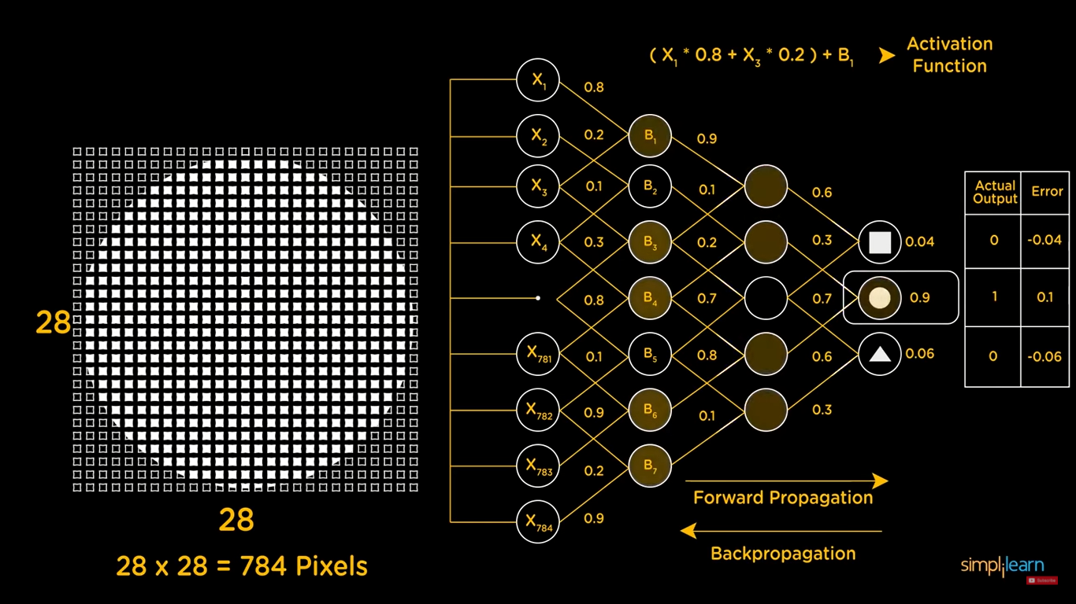
Example
What if the output generated is far away from the actual value? Using the output from the forward propagation, error is calculated. Based on this error value, the weights and biases of the neurons are updated. This process is known as back-propagation.
This circle of forward propagation and back propagation is iteratively performed.
This process continuous until the weights are assigned such that the network can predict the shapes correctly.

Slide 33
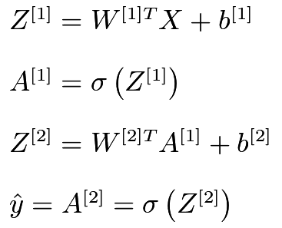
Shallow Networks
Shallow neural networks give us basic idea about deep neural network which consist of only 1 hidden layer.
Understanding a shallow neural network gives us an understanding into what exactly is going on inside a deep neural network
A neural network is built using various hidden layers. Now that we know the computations that occur in a particular layer, let us understand how the whole neural network computes the output for a given input X. These can also be called the forward-propagation equations
The first equation calculates the intermediate output Z[1]of the first hidden layer.
The second equation calculates the final output A[1]of the first hidden layer.
The third equation calculates the intermediate output Z[2]of the output layer.
The fourth equation calculates the final output A[2]of the output layer which is also the final output of the whole neural network.

Slide 34
Shallow to Deep Networks
MLPs can be extended to Deep Neural Networks with Multiple hidden layers
Hidden layers can automatically extract features from data
The bottom-most hidden layer captures very low level features (e.g., edges). Subsequent hidden layers learn progressively more high-level features (e.g., parts of objects) that are composed of previous layer’s features

